Slide 1

CUSTOMER PERSONALITY ANALYSIS
Group – 3
Mentor : Mr. Advaith
Presented by:
Chinmay Milind Nikumbh
Amol Shalikram Dongare
Sweety Rajendra Nandurkar
Tejas Hiraman Patil
Ankit Gurudas Chunarkar
Pugalendhi S
Rohit Sanjay Gadekar

Slide 2
Project Objective
Customer Personality Analysis is a detailed analysis of a company’s ideal customers. It helps a business to better understand its customers and makes it easier for them to modify products according to the specific needs, behaviors and concerns of different types of customers.
Target-
To Perform the clustering to summarize the customer Segments.

Slide 3
Factors affect marketing the products
People
Products
Promotions
Place

Slide 4
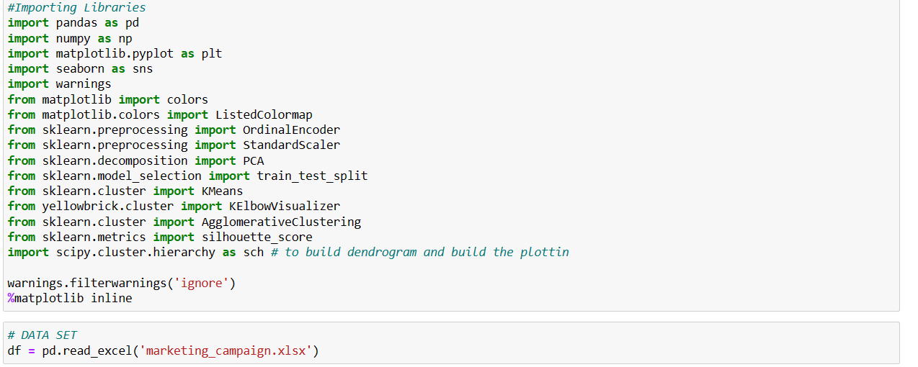
Data Set
Data set contain 2239 rows, 29columns
Marketing campaign data
Import all Required Libraries and dataset

Slide 5
Exploratory Data Analysis (EDA) and Feature Engineering

Slide 6
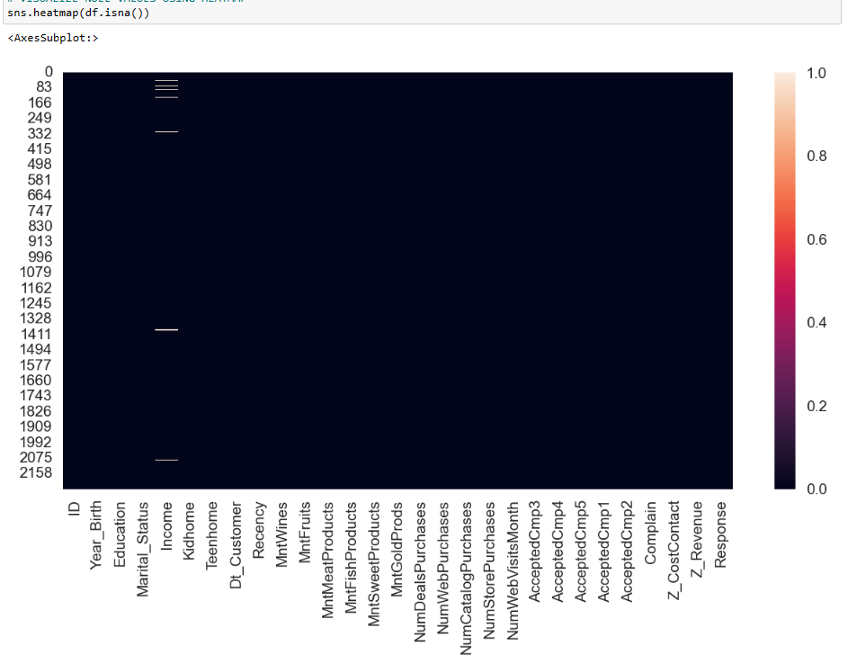
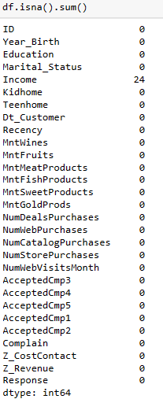
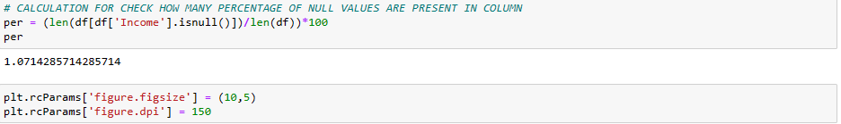
Check the Null values
Income column having 24 null values

Slide 7
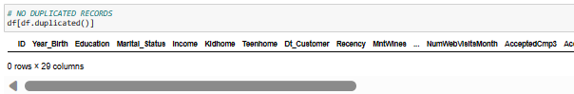
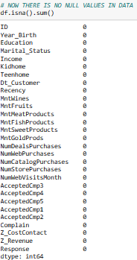
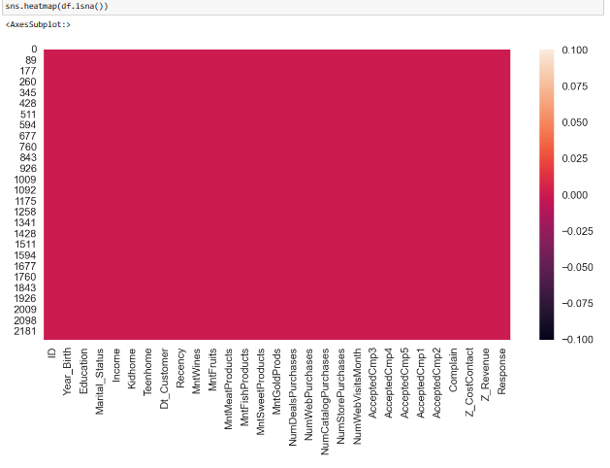
Remove the Null Values

Slide 8
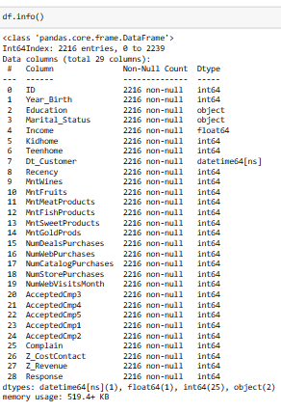
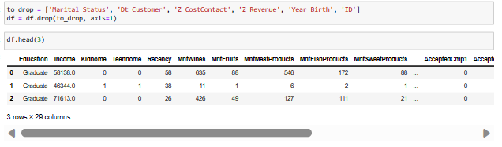
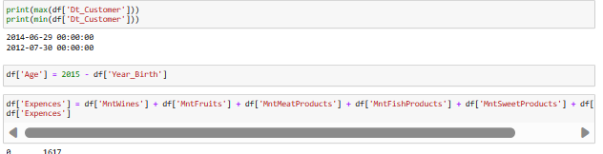
Check Data Types

Slide 9
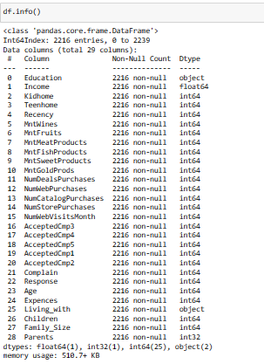
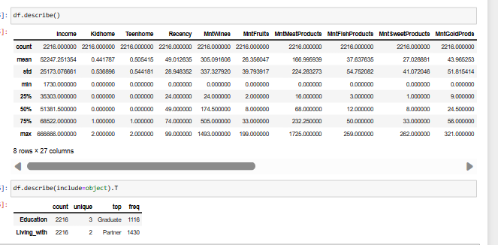
Data Analysis

Slide 10
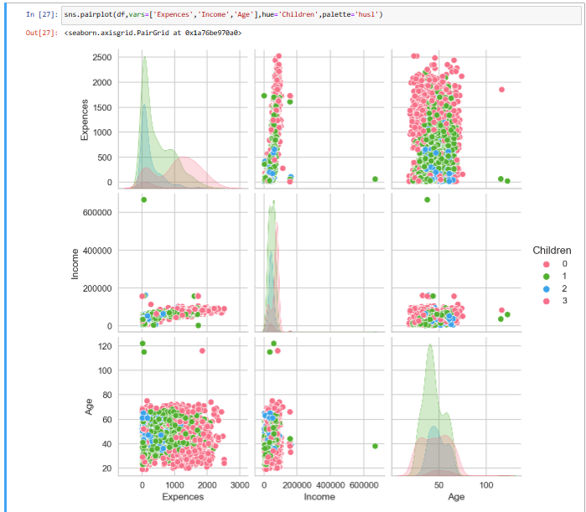
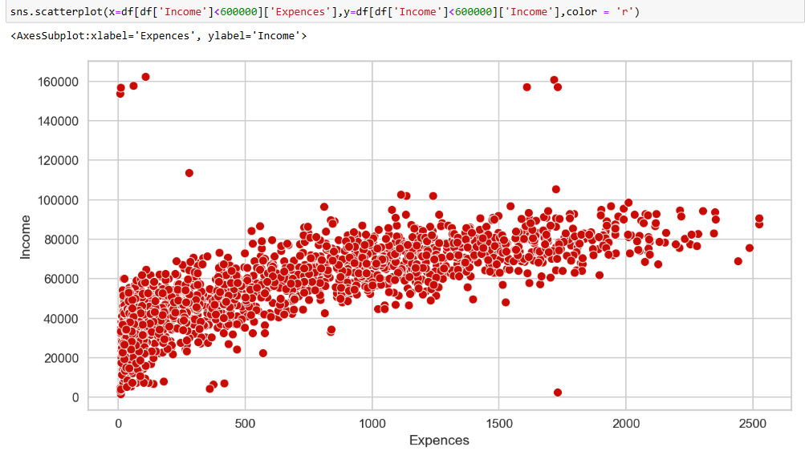
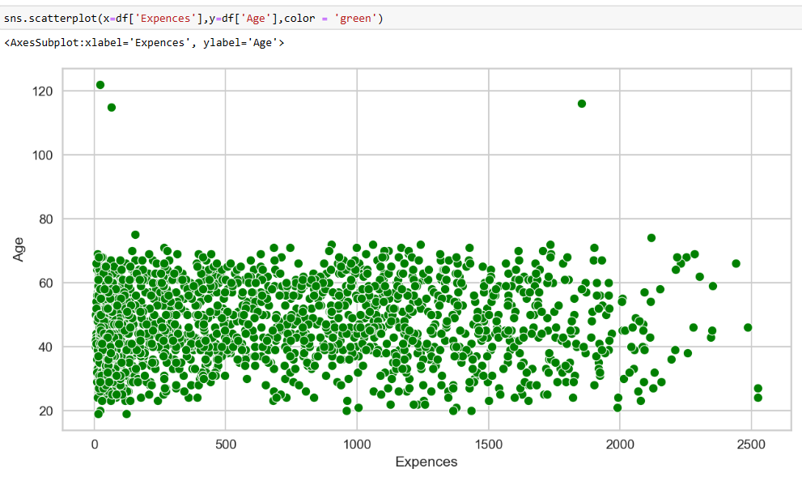
Pair plot and Scatter plot for Income ~ Expense ~Age

Slide 11
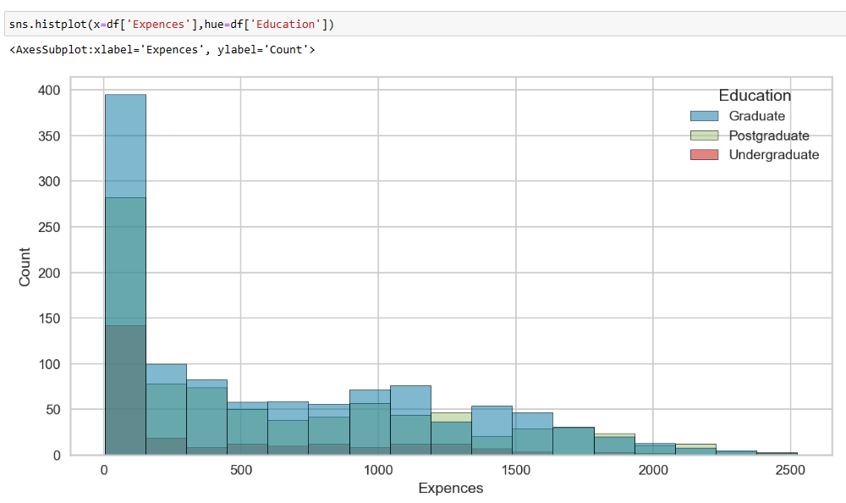
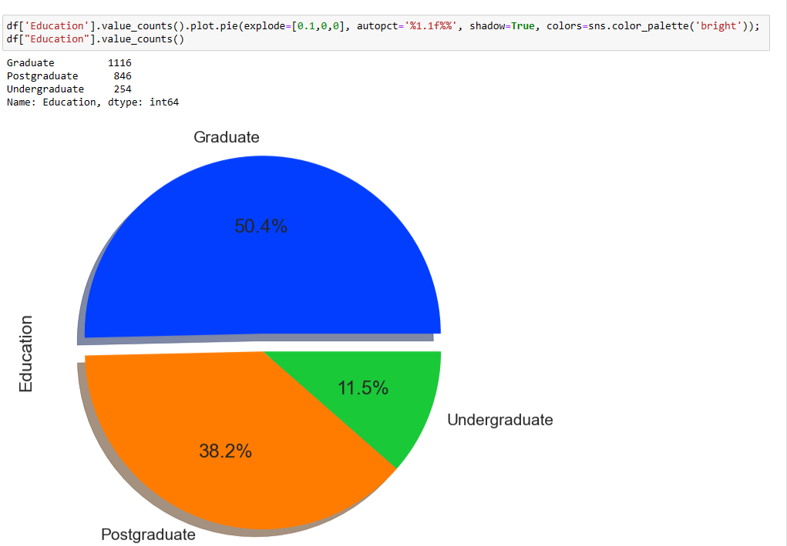
Histplot And Pieplot For Education Status

Slide 12
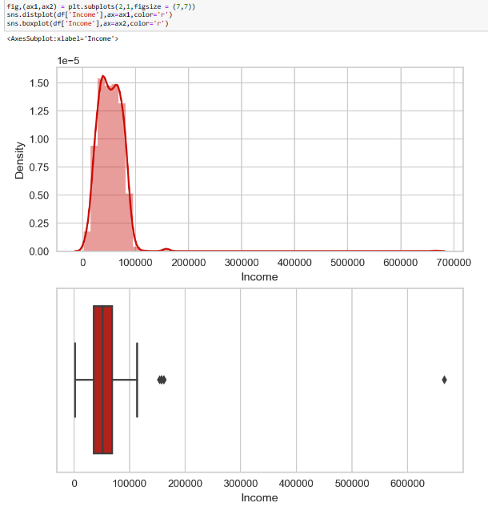
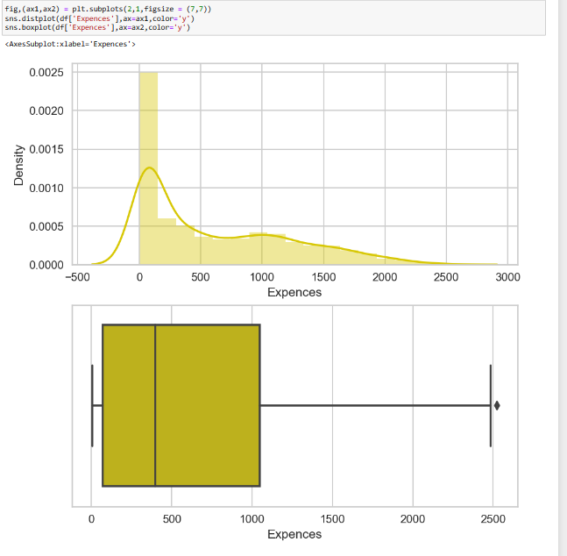
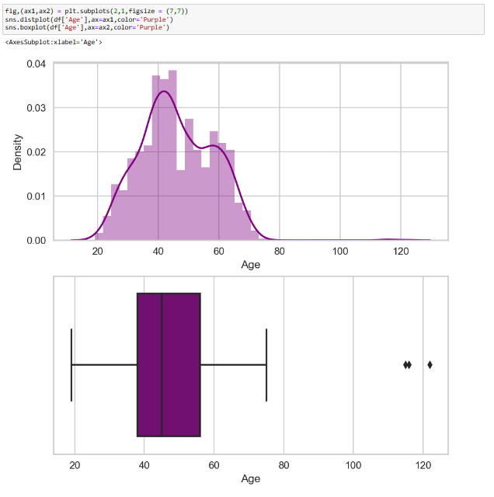
Outlier Detection

Slide 13
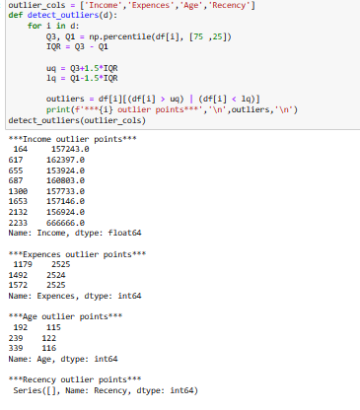
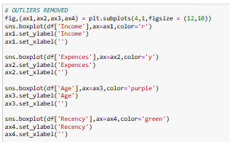
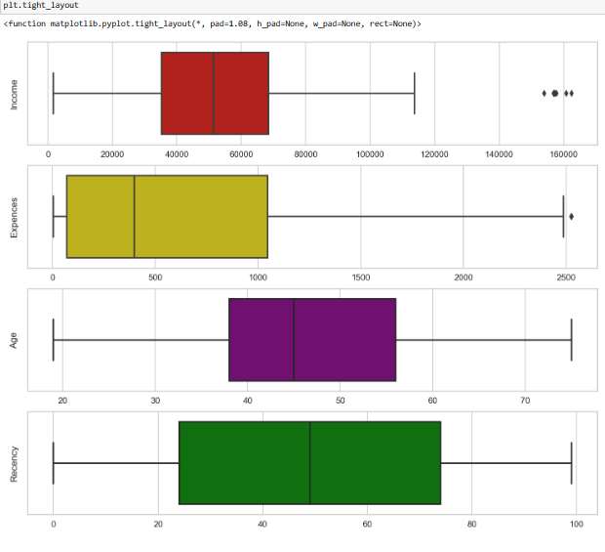
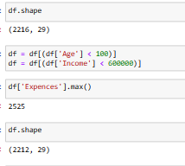
Treating Outliers with Capping Method

Slide 14
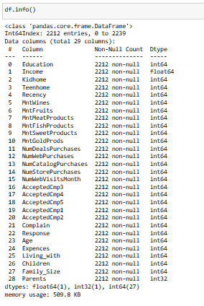
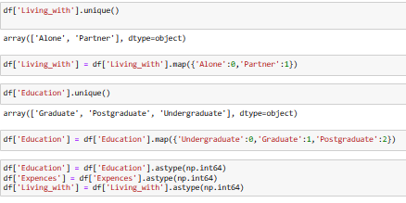
Encoding for Categorical Column

Slide 15
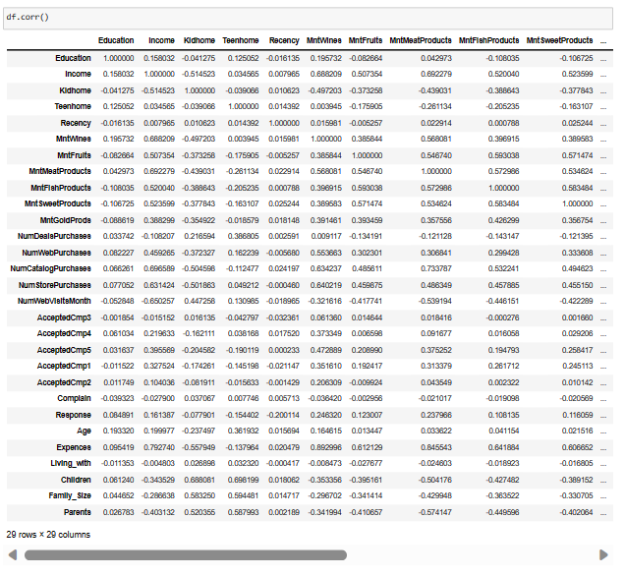
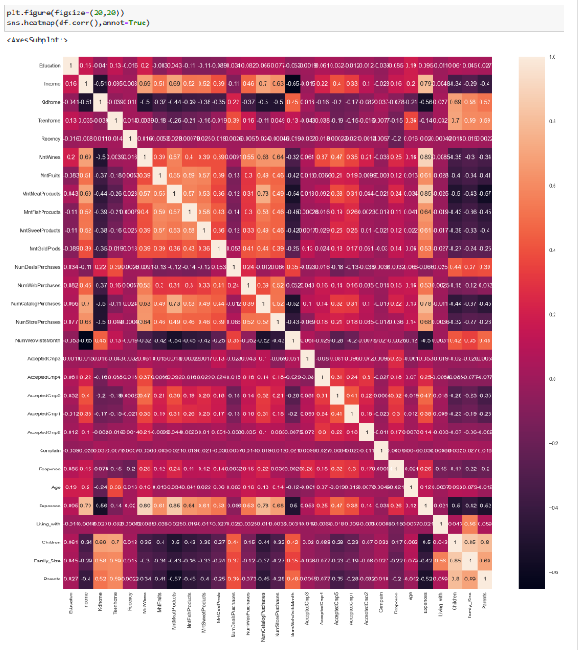
Correlation

Slide 16
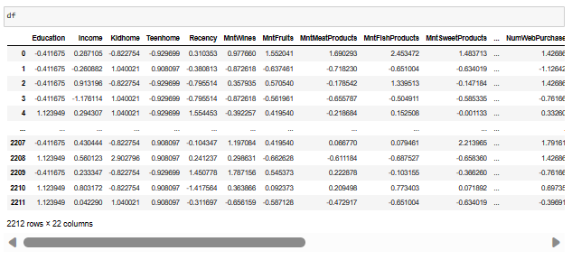
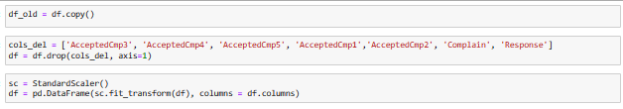
FEATURE SCALING

Slide 17
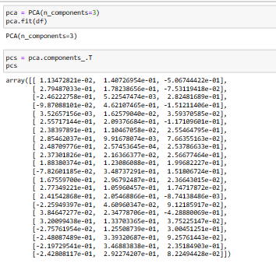
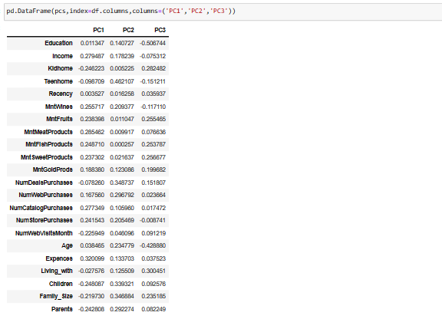
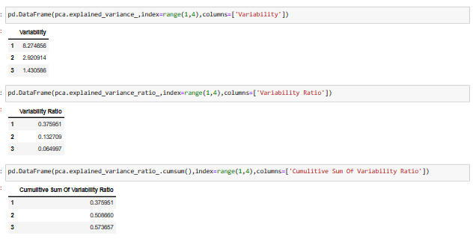
Dimensionality Reduction (PCA)

Slide 18
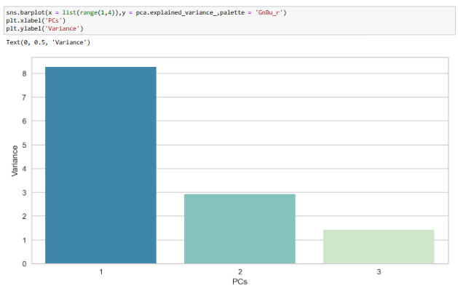
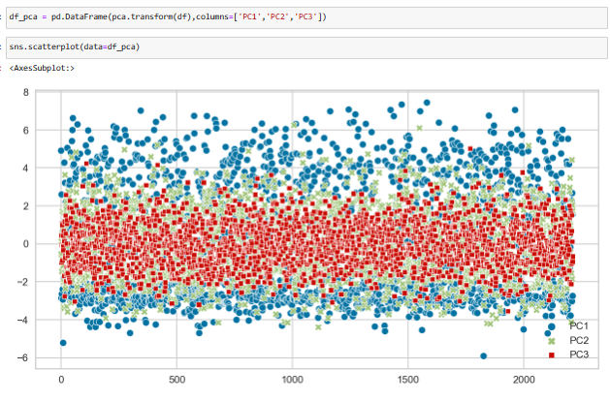
Barplot, Scatterplot for Variance (PCA)

Slide 19
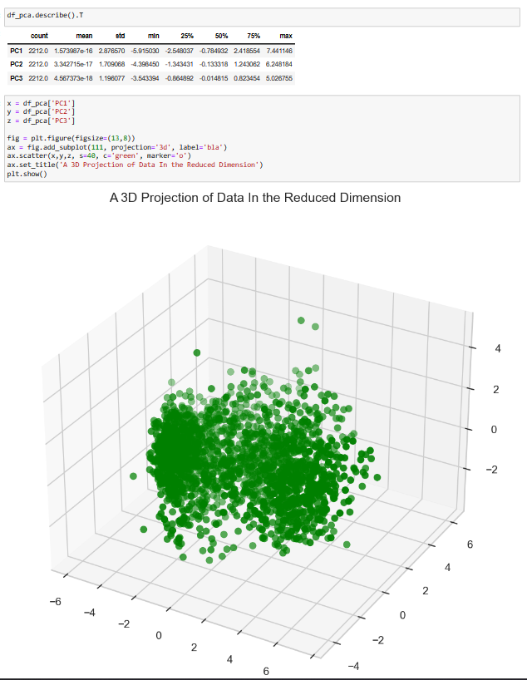
3D Projection of Data Dimension Reduction

Slide 20
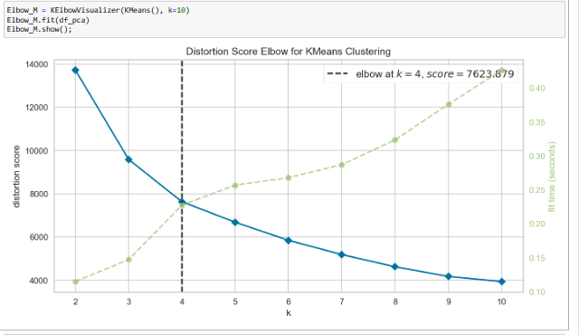
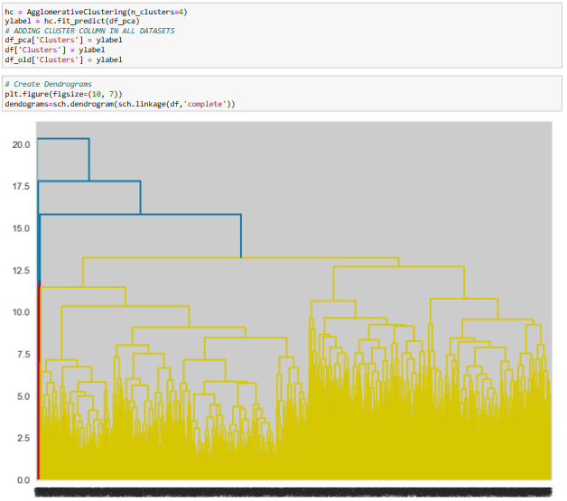
Clustering
K Means Clustering using ELBOW method

Slide 21
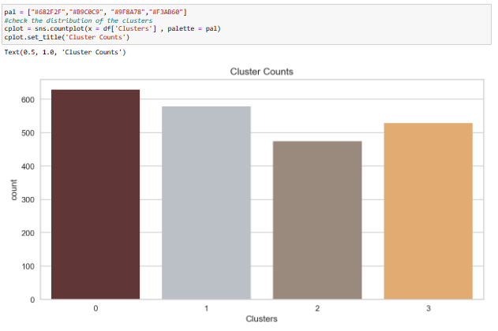
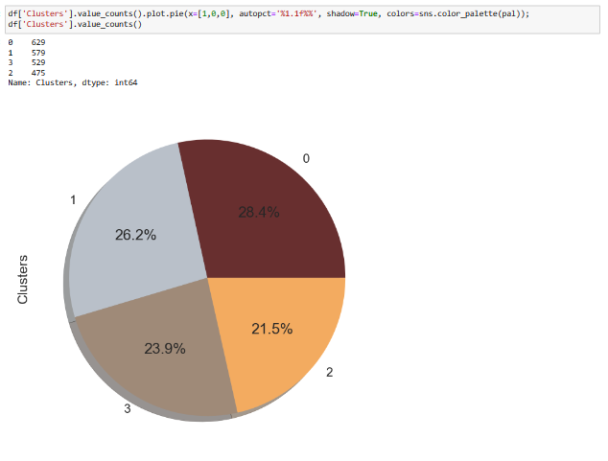
Distribution of Clusters

Slide 22
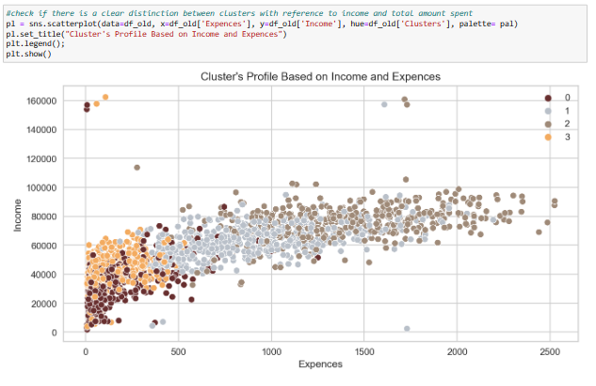
Distribution of Clusters

Slide 23
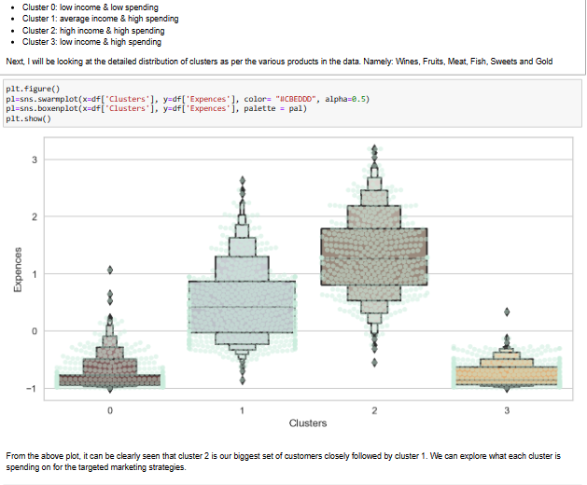
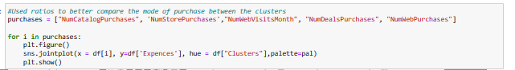
Income vs Spending plot shows the clusters pattern
From the above plot, it can be clearly seen that cluster 2 is our biggest set of customers closely followed by cluster 1.
We can explore what each cluster is spending on for the targeted marketing strategies.

Slide 24
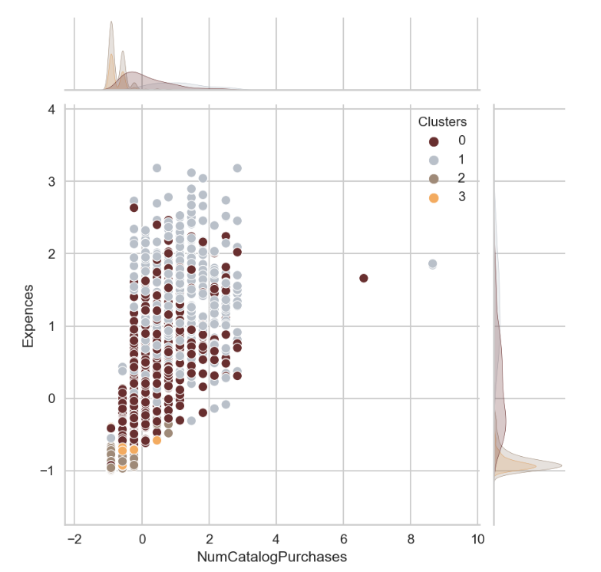
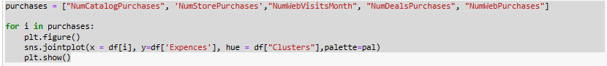
Mode of purchase between clusters
Used ratios to better compare
the mode of purchase between the clusters
Numcatalog purchases
Numstore purchases
Numwebvisits months
Numdeals purchases
Numweb purchases

Slide 25
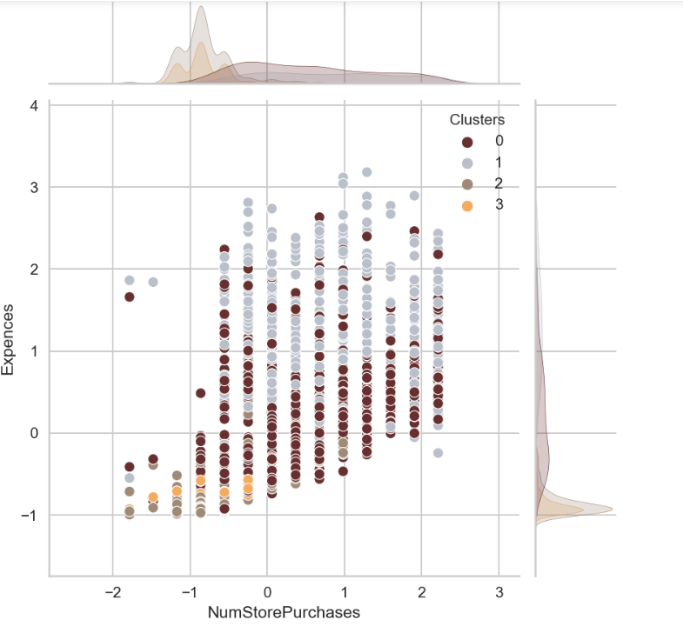
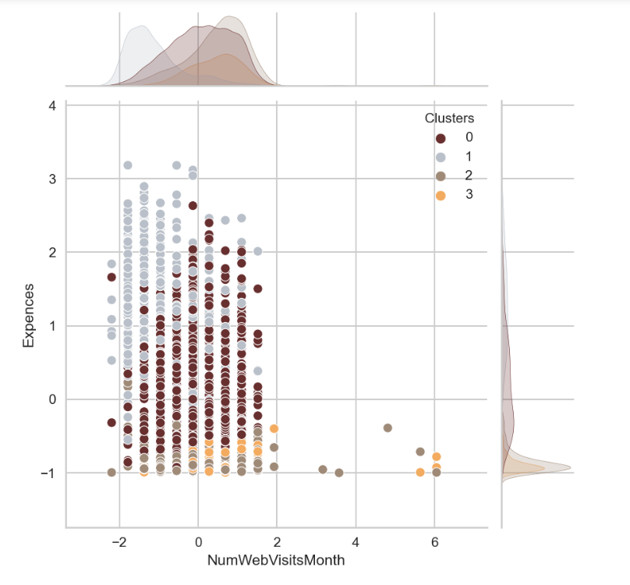

Slide 26
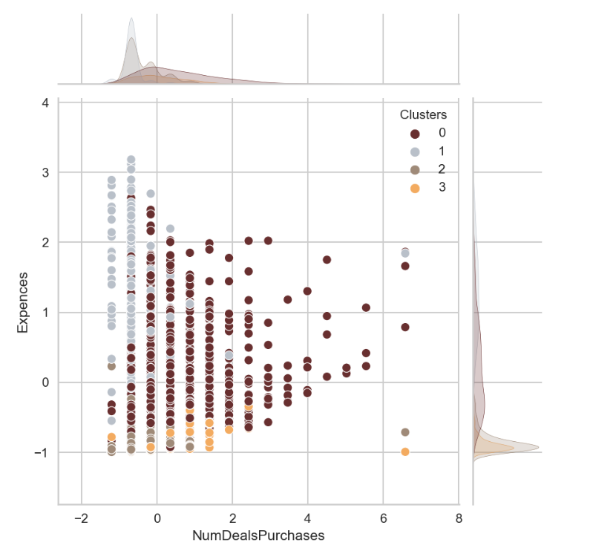
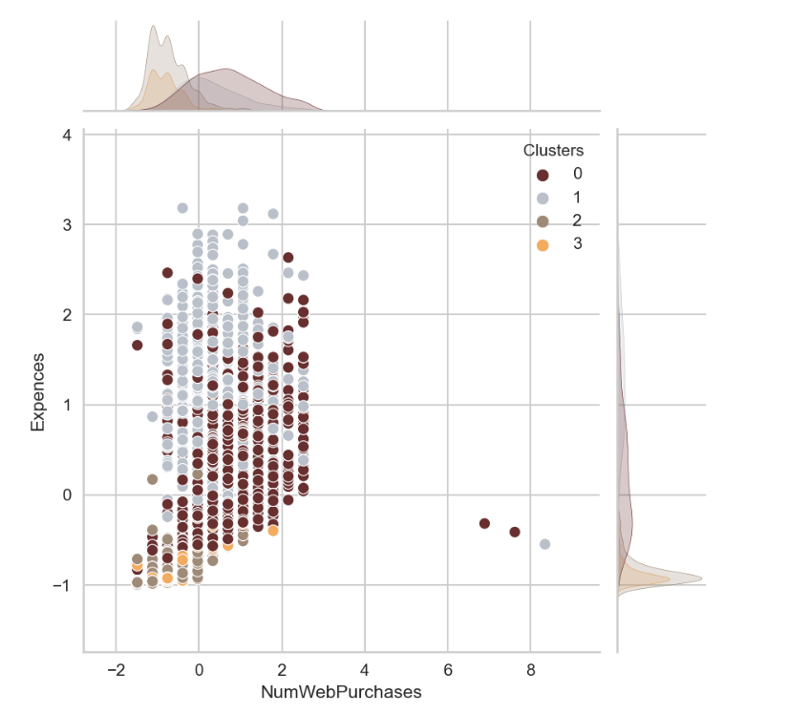

Slide 27
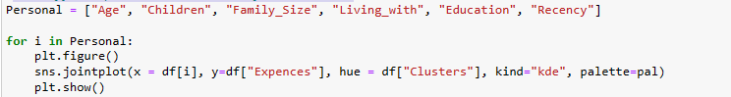
PROFILING
Identify the personal attributes of the clusters
Age
Children
Family with
Living with
Education
Recency
Let's take a deeper look at each cluster's individuals
now that we have built the clusters and looked at
their shopping patterns. To accomplish this,we will
analyse each cluster in order to identify which
consumers are the most valuable to us and which
ones the marketing department of the retail
business should focus on more.

Slide 28



Slide 29



Slide 30



Slide 31


Silhouette Score for Clustering

Slide 32


Algorithm Comparison

Slide 33


Ensemble Algorithm Comparison

Slide 34


Estimate accuracy on validation dataset using DecisionTreeClassifier

Slide 35

Deployment Stages
1.Dumping the Trained model file.
2. Creating the Basic Streamlit interface.
3. Integrating the streamlit interface with the model.
4. Creating the Web-app and optimizing it ergonomically.

Slide 36


Deployment in Action
Step1- Upload the Data Frame for Segmentation
Step2-
According to trained model the model will work on the dataset and predict the clusters/ Predictions

Slide 37

After the prediction it will list the predictions according to the groups.

Slide 38
Conclusion
Customers are the primary income for the business and without them the business won’t be able to survive in this competitive era. Hence, knowing what the customer wants based on his personality and likings makes the company’s task easier.
In this project, we performed unsupervised clustering. Applied dimensionality reduction technique followed by various clustering methods like K-Means Clustering, Agglomerative Clustering, Silhouette Score. We came up with 4 clusters and further used them in profiling customers in clusters according to their family structures, Age and income/Expenses. This can be used in planning better marketing strategies.
Implemented various models of Supervised Machine Learning Algorithm i.e. Logistics Regression, Decision Tree, Support Vector Machine and Naïve Bayes for the prediction of customer’s personality and decided to go with the stable model i.e. Decision Tree.

Slide 39
THANK YOU

